Slide 2
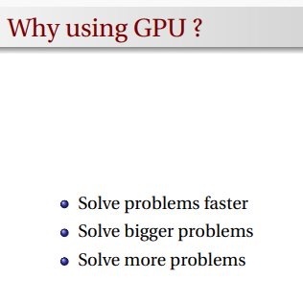

Slide 3
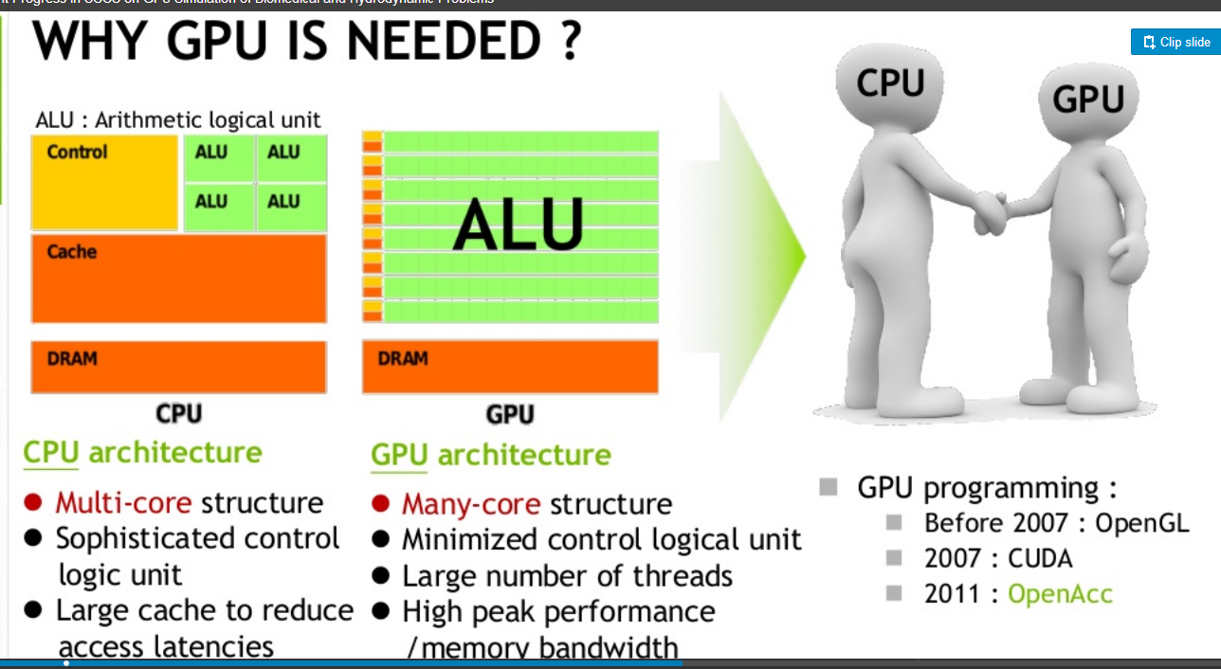

Slide 4
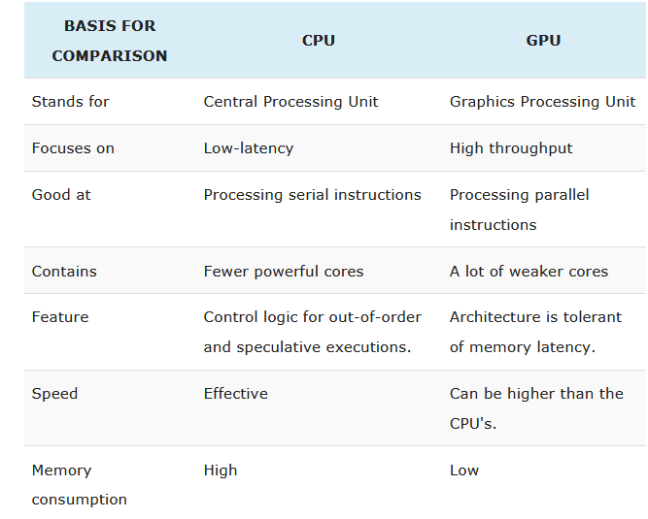

Slide 5
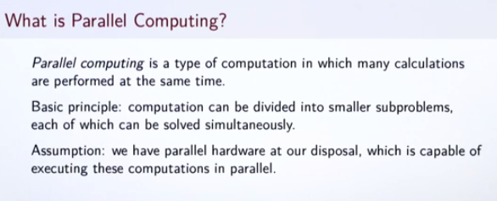

Slide 6
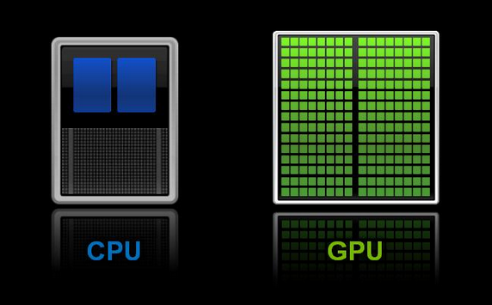
What Is a GPU?
The GPU’s advanced capabilities were originally used primarily for 3D game rendering. But now those capabilities are being harnessed more broadly to accelerate computational workloads in areas such as financial modeling, cutting-edge scientific research and oil and gas exploration

Slide 7
Architecturally, the CPU is composed of just few cores with lots of cache memory that can handle a few software threads at a time.
In contrast, a GPU is composed of hundreds of cores that can handle thousands of threads simultaneously.
The ability of a GPU with 100+ cores to process thousands of threads can accelerate some software by 100x over a CPU alone.
What’s more, the GPU achieves this acceleration while being more power- and cost-efficient than a CPU.

Slide 8
GPU forms
Terminology
In personal computers, there are two main forms of GPUs. Each has many synonyms:^{[57]}
Dedicated graphics card - also called discrete.
Integrated graphics - also called: shared graphics solutions, integrated graphics processors (IGP), or unified memory architecture (UMA).
Usage specific GPU
Most GPUs are designed for a specific usage, real-time 3D graphics or other mass calculations:
Gaming
GeForce GTX, RTX
nVidia Titan X
Radeon HD
Radeon r5, r7, r9, RX, and Vega series

Slide 9
Cloud Gaming
nVidia Grid
Radeon Sky
Workstation
nVidia Quadro
nVidia Titan X
AMD FirePro
Radeon Pro
Cloud Workstation
nVidia Tesla
AMD FireStream
Artificial Intelligence Cloud
nVidia Tesla
Radeon Instinct
Automated/Driverless car
nVidia Drive PX

Slide 10
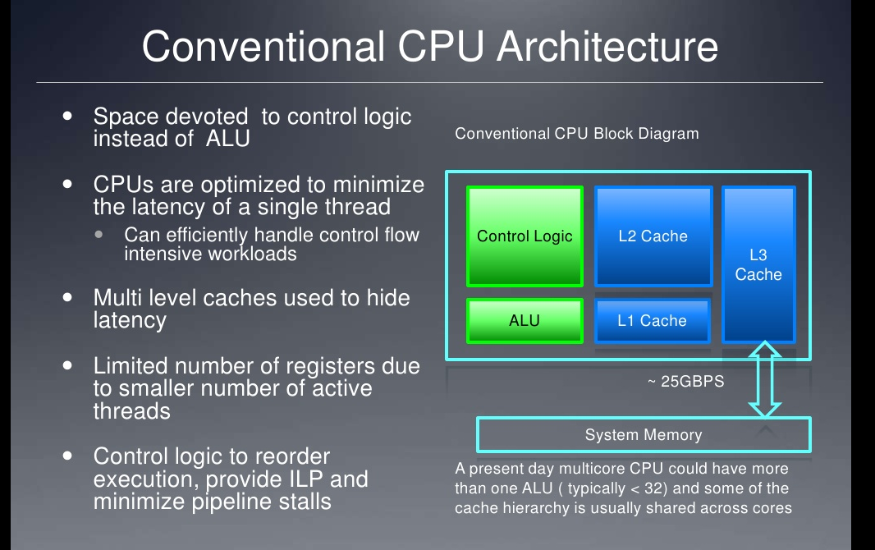

Slide 11
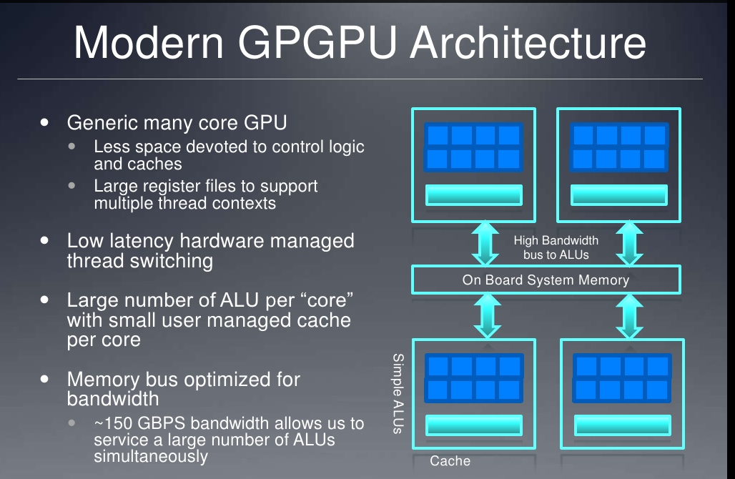

Slide 12
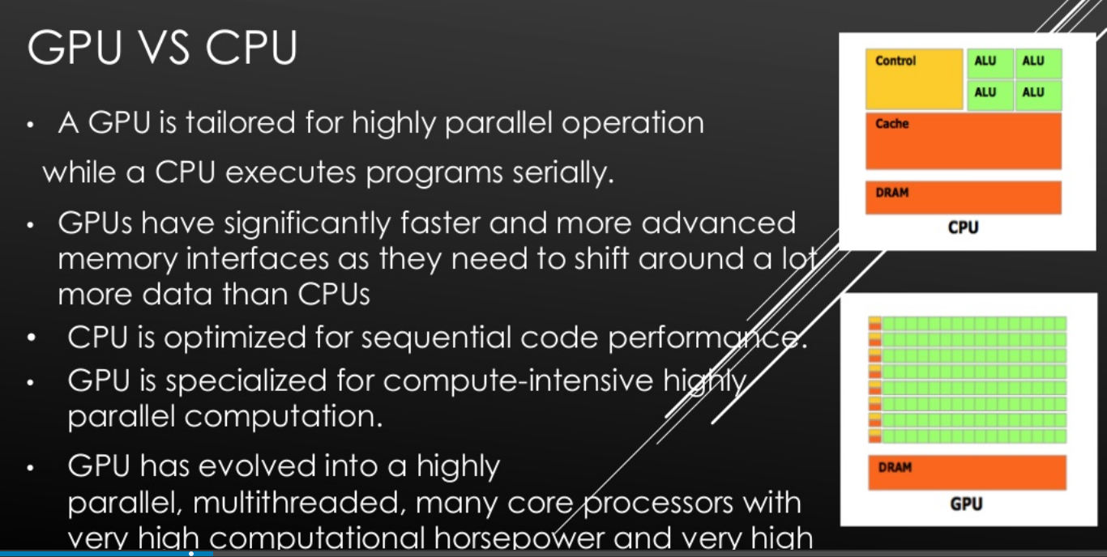

Slide 13
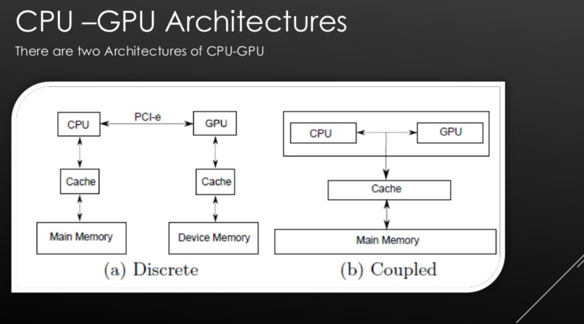

Slide 14
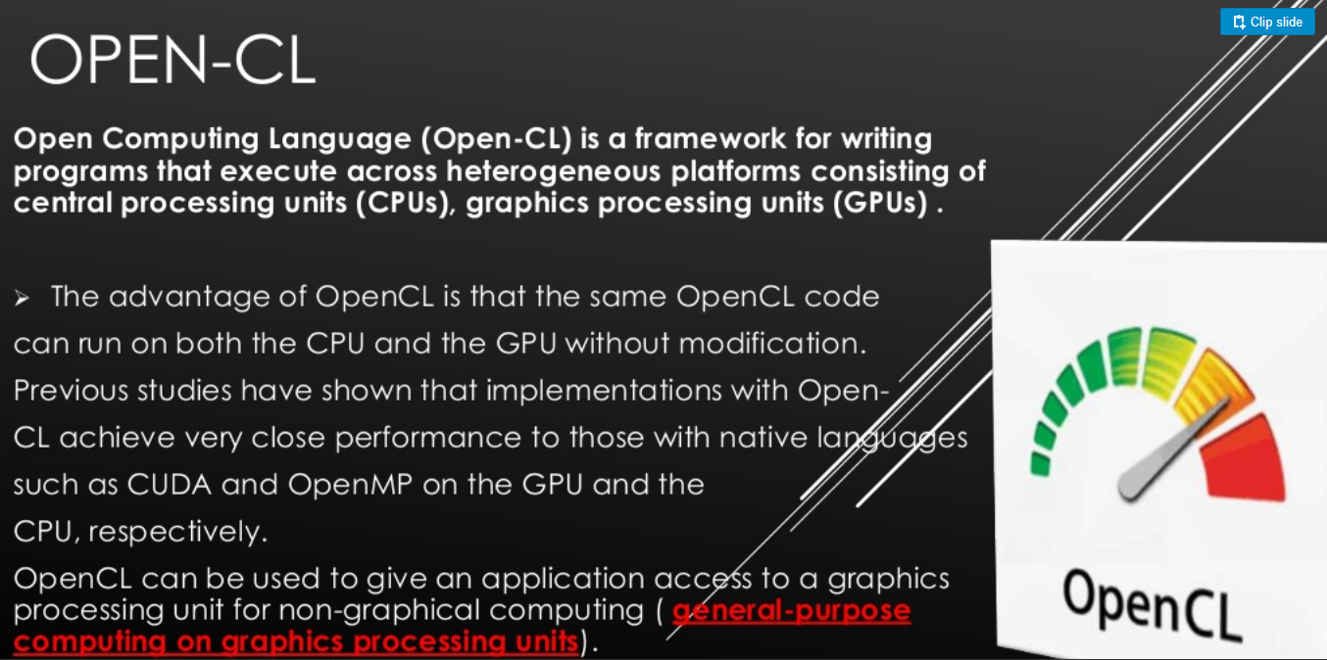

Slide 15
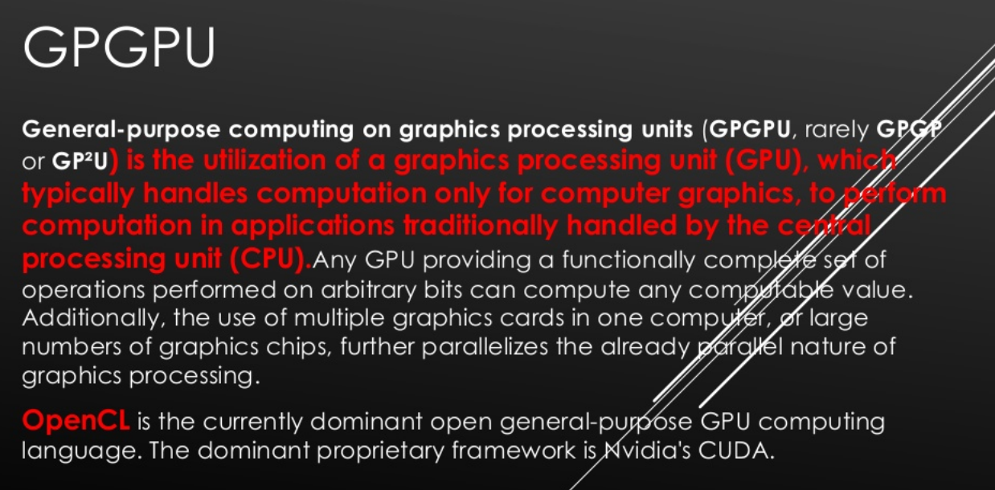

Slide 16
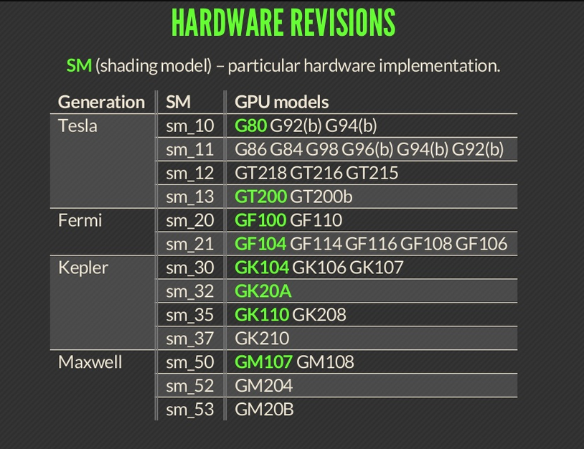

Slide 17
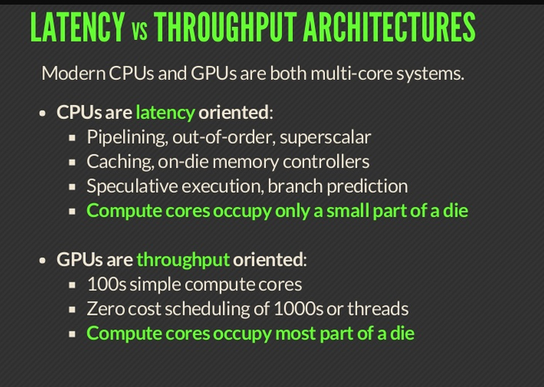

Slide 18
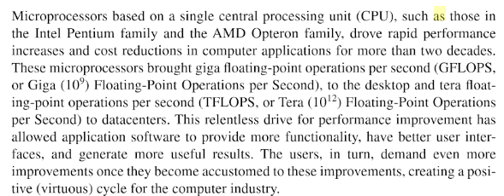

Slide 19
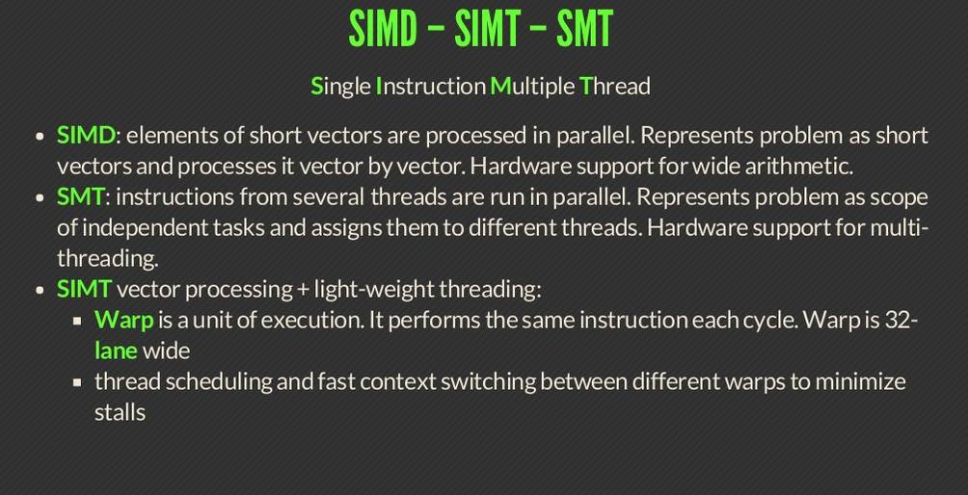

Slide 20
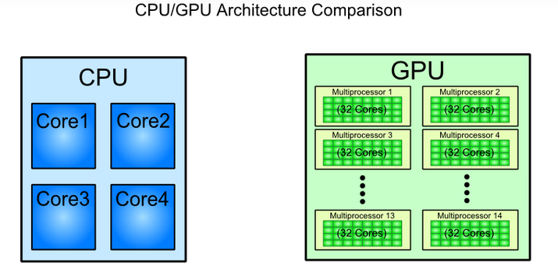

Slide 21
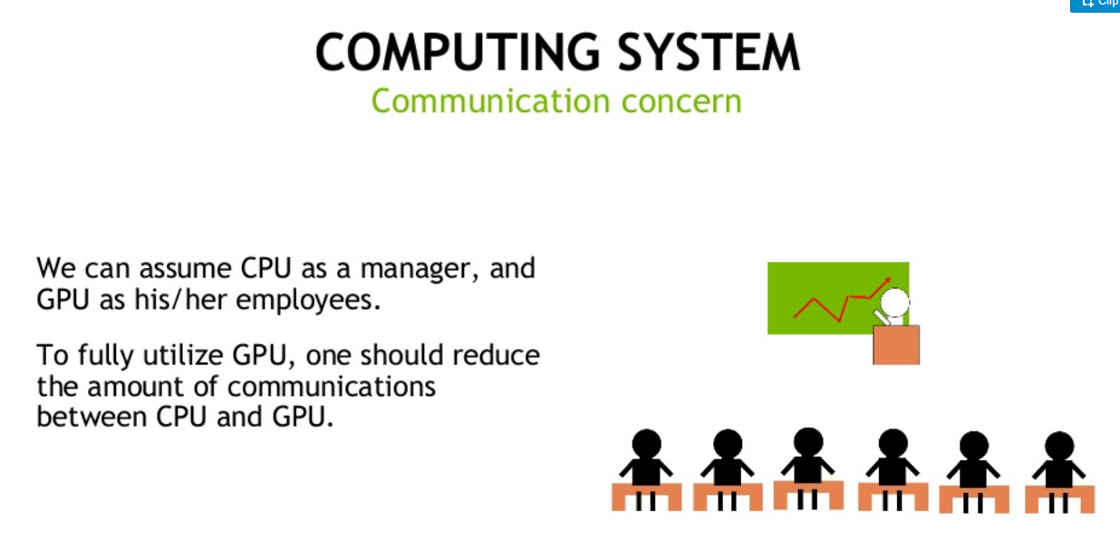

Slide 22
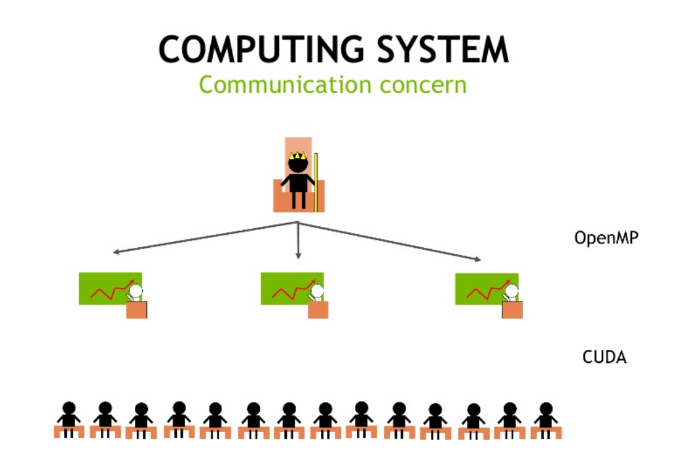

Slide 23
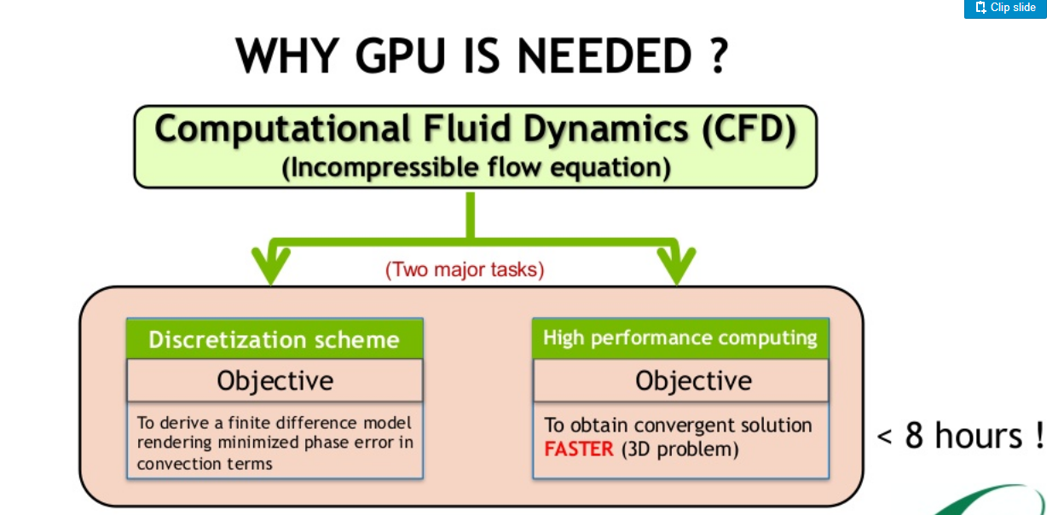

Slide 24
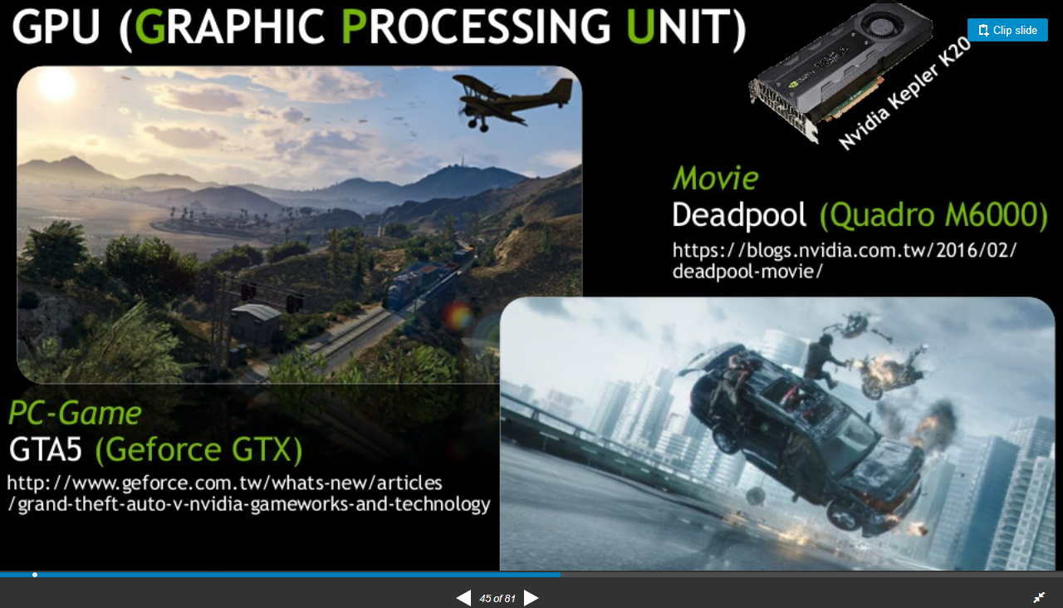

Slide 25
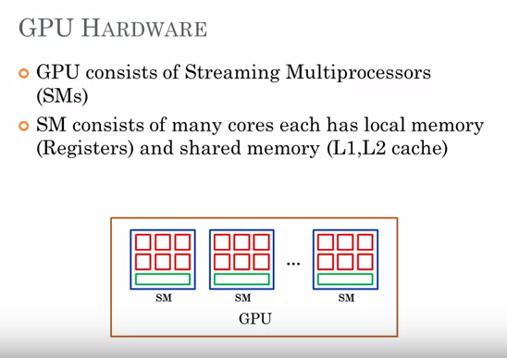

Slide 26
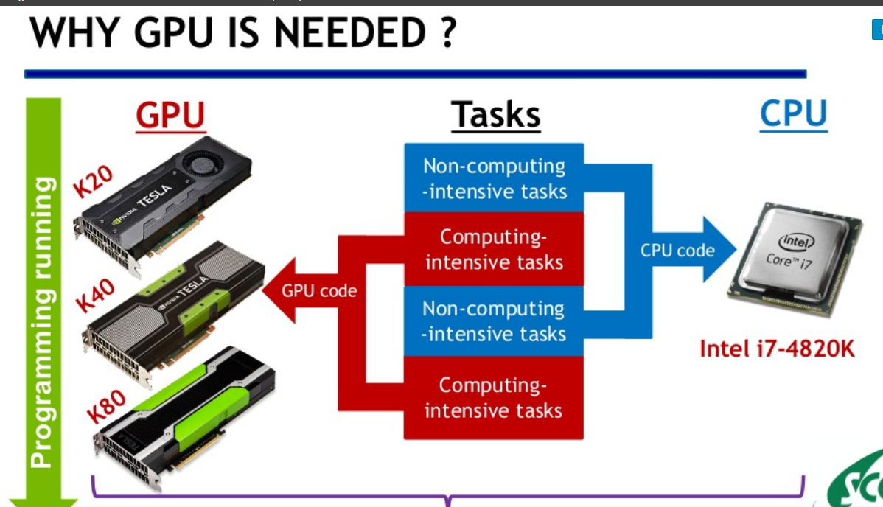
Notes:
https://www.slideshare.net/NVIDIATaiwan/3-1-32-gtc2016ntusccs0921

Slide 27
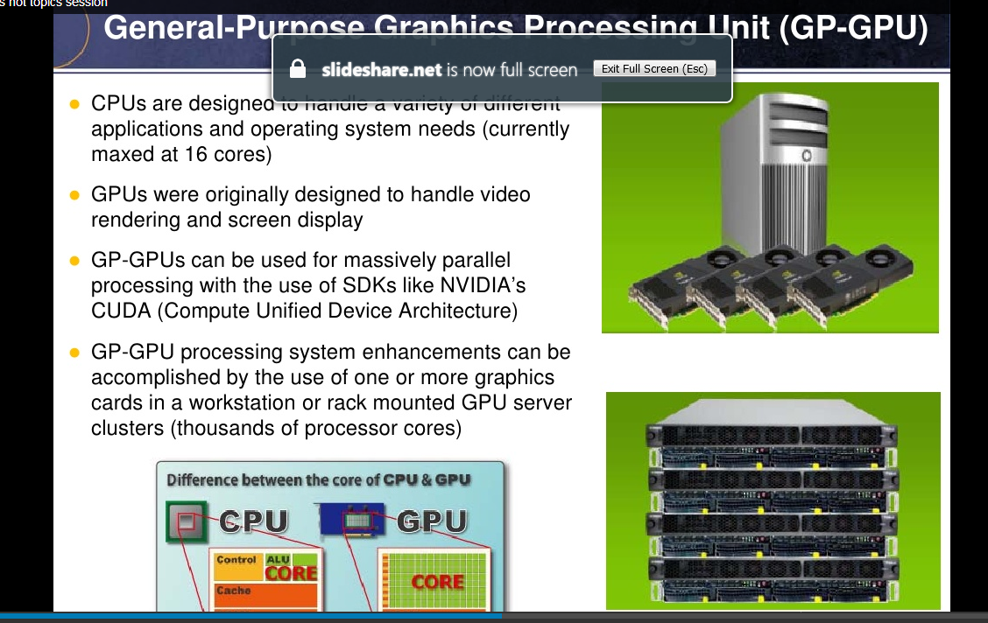

Slide 28
Definition of CPU
CPU (Central Processing Unit) is a device primarily acts as the brain for every embedded system. It consists of an ALU (Arithmetic Logic Unit) used to temporarily store the data and perform calculations and a CU (Control Unit) which performs instruction sequencing and branching. It also interacts to the other units of the computer such as memory, input and output, for executing the instruction from the memory this is the reason an interface is also a crucial part of the CPU. The I/O interface is sometimes included in the control unit.
It provides address, data and control signal while receives instructions, data, status signal and interrupt which is processed with the help of the system bus. A system bus is a group of various busses such as address, control and data bus. The CPU assigns more hardware unit to fast cache while low to computation, unlike GPU.

Slide 29
Definition of GPU
The GPU (Graphics Processing Unit) is a processor specifically designed for computing the graphical displays. It is typically incorporated with CPU for sharing RAM with CPU which is good for the most computing task. It is needed for the high-end graphics intensive processing. The discrete GPU unit contains its own RAM known as VRAM for video RAM. The advanced GPU system cooperatively works with the multi-core CPUs. At first, the graphics unit was introduced by the Intel and IBM in the 1980s. These cards were enabled with simple functionalities such as area filling, alteration of simple images, shape drawing and so on.
The modern graphics are capable of performing the research and analysis task, often surpassing CPUs because of its extreme parallel processing. In the GPU the several processing units are stripped together where no cache coherency exist.

Slide 30
Key Differences Between CPU and GPU
In CPU’s the priority is given to the low-latency whereas the GPU is optimized for throughput where the number of calculation performed in a time interval must be high or as much as possible.
The CPU provides more effective results when processing of serial instructions is involved. On the other hand, the GPU process parallel instructions in a more effective way.
A CPU is comprised of less number of powerful cores. In contrast, the GPU is constructed through a large number of weak cores.
The GPU can achieve a high speed comparative to the CPU because of its immense parallel processing.
The CPU requires more memory for processing while comparatively, GPU needs less memory.

Slide 31
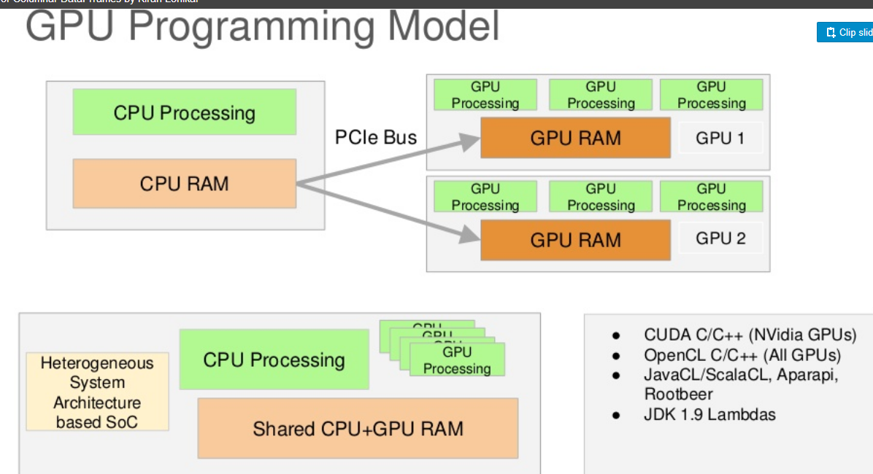

Slide 32
The GPU is designed as a single instruction, multiple data (SIMD) processing engine built for massively parallel workloads. 3D graphics is one of the best examples of high throughput parallel processing since GPUs can process billions of pixels/vertices or floating-point operations (GFLOPS) every second. At the heart of the GPU are one or more shaders (SIMD units) that process independent vertices, primitives, and fragments (pixels). Shaders are computing elements that execute 3D graphics programs per-vertex, per-pixel, or other primitive basis.

Slide 33
Figure 1 shows some of the major differences between CPU and GPU architectures. Each design has its strong points and must work in tandem to achieve the most optimized solution (power, bandwidth, resource sharing, etc.). The best designs use a heterogeneous system architecture that splits/assigns workloads to each processing core based on its strengths. The GPU is also becoming an important part of the system as the industry moves toward platform-level optimizations where the GPU is used for computational intensive applications beyond graphics. Note that in today’s hybrid designs, there are other computational blocks including DSPs, FPGAs, and other task specific cores that can be used together with the CPU-GPU combination.

Slide 34
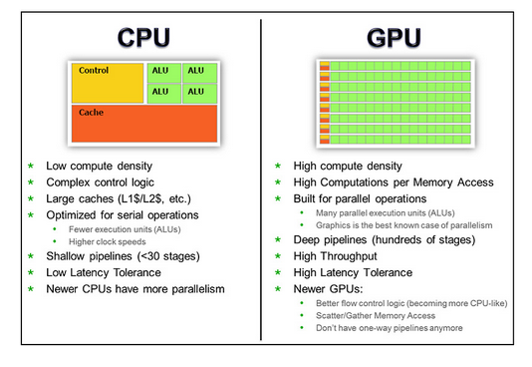
Newer GPUs use “unified” shaders to achieve the best hardware resource management across different types of shader programs to balance workloads. The first versions of unified shaders combined vertex (VS) and pixel (PS) processing, with subsequent versions adding support for geometry (GS), tessellation (TS), and compute (CS) shaders as graphics APIs advanced.

Slide 35
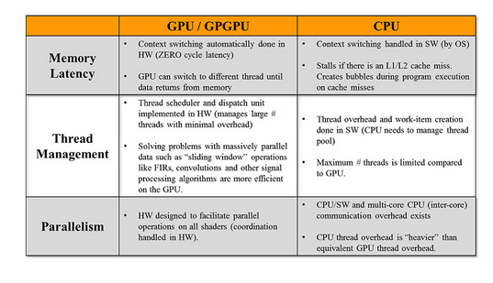

Slide 36
Many computational problems like image processing, vision processing, analytics, mathematical calculations, and other parallel algorithms map well to the GPU SIMD architecture. You can even program the GPU to use a multi-GPU approach where a compute task and/or 3D rendering frame is split between GPUs to improve performance and throughput. The GPU can work in multi-context modes to execute 3D and compute threads simultaneously. An example would be where GPU core 1 and 2 are assigned to render images and core 3 and 4 are dedicated to GPGPU functions like particle effects (smoke/water/fire), game physics to mimic real world motion, or natural user interface (NUI) processing for gesture support. Other markets where the GPGPU is being adopted, especially in embedded/computer vision segments, include:

Slide 37
Augmented reality: overlays the real world environment with GPU-generated data (images, data, 3D renderings, etc.) that can be input from various sensors, like Google Glass. AR can work with online (live and direct) or offline content streams.
Feature extraction: vital to many vision algorithms since image “interest points” and descriptors need to be created so the GPU knows what to process. SURF (Speeded Up Robust Features) and SIFT are examples of algorithms that can be parallelized effectively on the GPU. Object recognition and sign recognition are forms of this application.
Point cloud processing: includes feature extraction to create 3D images to detect shapes and segment objects in a cluttered image. Uses could include adding augmented reality to street view maps.
Advanced driver assistance systems (ADAS): multiple safety features are constantly calculated in real time including line detection/lane assist (Hough Transform, Sobel/Canny algorithms), pedestrian detection (Histogram of Oriented Gradients, or HOGS), image de-warping, blind spot detection, and others.
Security and surveillance: includes face recognition that goes through face landmark localization (Haar feature classifiers), face feature extraction and classification, and object recognition.
Motion processing: natural user interfaces like hand-gesture recognition which separates the hand from background (like color space conversion to the HSV color space) and then performs structural analysis on the hand to process motion.
Video processing: HEVC video co-processing using shader programs and high speed integer/floating point computations.
Image processing: combining GPGPUs with image signal processors (ISP) for a streamlined image-processing pipeline.
Sensor fusion: blends vision processing with other sensor data (like LIDAR) to create a 3D spatial map with depth. A similar concept used in graphics is ray tracing, where you shoot out a ray and trace its path through an image and calculate all the ray-object intersections and bounces to generate a realistic 3D image.

Slide 38
